Slide 1
Interstitial Lung Disease(ILD)
or
Diffuse Parenchymal Lung Disease (DPLD)
Abdellah Hamed
MD, Phd (Japan)
Lecturer of Respirology
Sohag University

Slide 2
Outline
Introduction
Classification
Epidemiology
Pathogenesis
Clinical features
Investigation
Treatment

Slide 3
introduction
Interstitial Lung Disease refers to a broad range of conditions that have common clinical, physiological, and radiological features.
ILD is not one disease but several diseases that do not necessarily share a common histopathological or pathophysiological basis

Slide 4
HAMMAN and RICH were the first to describe (in 1935 and 1944) four patients who died of rapidly progressive lung disease characterized by diffuse interstitial pneumonia and fibrosis.
Interstitium
Refers to the microscopic anatomic space bounded by the basement membrane of epithelial and endothelial cells.
Within this interstitial space, fibroblast like cells (mesenchymal and connective tissue cells) and extracellular matrix components (interstitial collagens, elastin, proteoglycans) are present

Slide 5
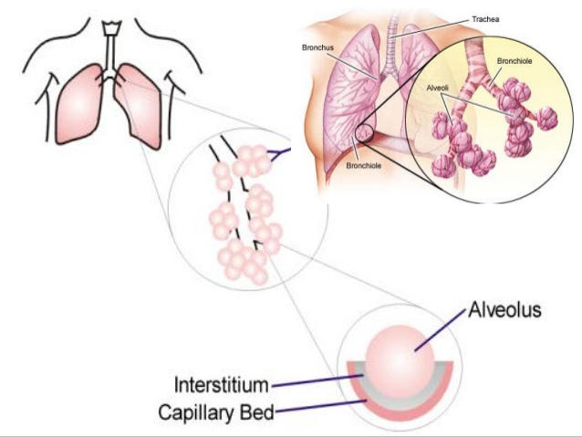
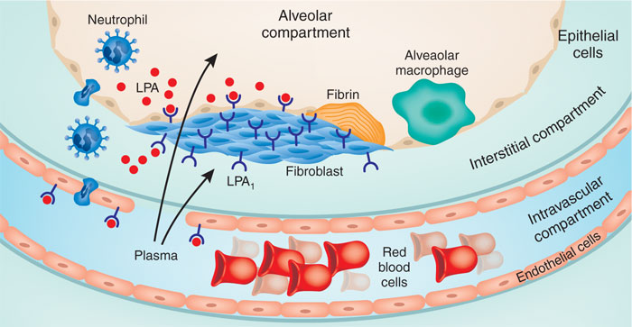
Introduction
By strict definition Interstitial lung disease involves abnormalities of the interstitium – “the potential space between the epithelium and capillary endothelial basement membrane within the alveolus”. HOWEVER…………..

Slide 6
Introduction
Interstitial is a misleading terminology because most of these disorders are associated with extensive alteration of airway and alveolar architecture in addition to changes in interstitial compartment.
For this reason Diffuse Parenchymal Lung Disease or DPLD is the better term.

Slide 7
Classification of dpld
DPLD : Two large groups
Idiopathic DPLD ( no known cause )
(2)Secondary to other diseases

Slide 8
classification

Slide 9
Clinical Classification
Idiopathic IPF
Occupational
Connective Tissue Diseases
Sarcoidosis
Drug induced

Slide 10
Idiopathic
Acute interstitial pneumonitis (Hamman-Rich syndrome)
Usual Interstitial pneumonitis
Desquamative interstitial pneumonitis
Respiratory bronchiolitis
Cryptogenic organizing pneumonia
Nonspecific interstitial pneumonitis
Lymphocytic interstitial pneumonia

Slide 11
CTD
Scleroderma
Polymyositis-dermatomyositis
Systemic lupus erythematosus
Rheumatoid arthritis**
Mixed connective tissue disease
Ankylosing spondylitis
Behcet’s
Sjogren’s syndrome

Slide 12
Occupational

Slide 13
Inorganic dusts
Silica
Asbestos
Aluminum
Coal dust.
Beryllium.
Mixed dusts
Hard metal : Titanium oxide, tungsten cadmium.

Slide 14
Organic dusts : Hypersensitivity Pneumonitis
Farmer lung
Bagassosis
Humidifier lung, air cond.
Bird breeder’s lung

Slide 15
Drugs
Chemotherapy : bleomycin,
cyclophosphamide, methotrexate, procarbazine.
Antiarrhythmic agents Amiodarone (Cordarone) is an antiarrhythmic medication used to treat ventricular tachycardia or ventricular fibrillation
Anti-epileptic drugs
Valproic acid ( Depakine).
Radiotherapy

Slide 16
Epidemiology
Incidence ranges from 3-26/1,00,000 per year.
Prevalence of preclinical and undiagnosed ILD is estimated to be 10 times that of clinical recognized disease.
IPF is the most common form representing at least 30 percent of the incident cases.

Slide 17
PATHOGENESIS

Slide 18
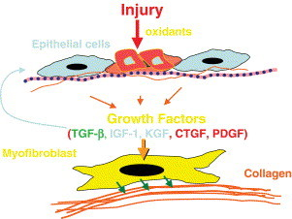
Pathogenesis
Epithelial cell apoptosis with loss of basement membrane integrity: production of growth factors
in response to alveolar epithelial injury with hyperplastic type II cells and myofibroblast recruitment

Slide 19
Diagnosis

Slide 20
Approach to the Diagnosis of ILD
Clinical
History
Physical
Laboratory
PFTs
Pathology
Surgical lung biopsy
Radiology
Chest X-ray
HRCT
Notes:
Approach to the Diagnosis of IPF
The current recommended approach to diagnosing IPF is multidimensional and multidisciplinary, comprising clinical, radiologic, and pathologic assessments and relying on the expertise of pulmonologists, pathologists, radiologists, and primary care physicians.
Clinical evaluation begins with a thorough and extensive medical history including signs and symptoms, family history, and medication use. Dyspnea is the most prominent presenting symptom of IPF. Physical exam may reveal “velcro-like” crackles, most prominent at the lung bases, in more than 80% of patients. As the disease progresses, rales, clubbing (in 25% to 50% of patients), or cyanosis may develop. A routine laboratory evaluation is often helpful to rule out other causes of diffuse parenchymal lung disease. Pulmonary function tests typically reveal a restrictive pattern (reduced vital capacity and total lung capacity) and impaired gas exchange (reduced DL_{CO}). Resting arterial blood gases may be normal; however, exercise typically results in an O₂ desaturation.
Chest x-rays may reveal bilateral reticular opacities with a basal predominance. Importantly, however, a normal chest x-ray does not exclude a diagnosis of IPF.
Usual interstitial pneumonia is the histopathological pattern associated with the clinical entity of IPF, and can best be identified through surgical lung biopsy (thoracotomy or VATS).

Slide 21
Respiratory SYMPTOMS
Breathlessness (most common): Initially, dyspnea on exertion→ later at rest
Nonproductive cough
Pleuritic chest pain
Wheeing
Hemoptysis

Slide 22
Non Respiratory symptoms
Arthritis
Ocular
Skin and muscle
GERD
Lower GI symptoms
Recurrent sinusitis
Neurological symptoms
Epilepsy & mental retardation
Diabetes inspidus

Slide 23
ONSET OF SYMPTOMS
Acute presentation (days to weeks)- eg: Acute idiopathic interstitial pneumoni,Hypersensitive pneumonitis
Sub-acute presentation (weeks to months)- eg: Sarcoidosis,Drug induced ILD ,Alveolar hemorrhage syndromes
Chronic presentation (months to years) – eg: IPF

Slide 24
ILD-HISTORY
Smoking
Medication history- Amiodorane, Methotrexate,
Occupational history
Environmental exposure history

Slide 25
Occupational history
􀂾 Pneumoconioses – miners
􀂾 Silicosis – sand blasters & granite workers
􀂾 Asbestosis – welders, electricians, mechanics, workers with
brakes, shipyard workers
􀂾 Berylliosis – aerospace, nuclear, computer & electronic industries
􀂾 Hypersensitive pneumonitis – farm workers, poultry workers,
bird breeders
􀂄 The degree of exposure, duration, latency of exposure, and the
use of protective devices should be elicited

Slide 26
Environmental exposure history
􀂾 Exposures to pets (especially birds)
􀂾 Air conditioners
􀂾 Humidifiers
􀂾 Hot tubs
􀂾 Evaporative cooling systems

Slide 27
ILD-SIGNS
Crackles - Dry, velcro , end inspiratory, predominantly bibasilar
Inspiratory squeaks- Mid inspiratory wheez, high pitched- Seen in Small Airway pathologies
Cor pulmonale features
Clubbing – IPF
Cyanosis

Slide 28
Extra Pulmonary -SIGNS
Skin abnormalities
Lymphadenopathy
Hepatosplenomegaly
Maculopapular skin rashes
Erythema nodosum
Subcutaneous nodules
Proximal muscle weakness
Arthritis

Slide 29
INVESTIGATIONS

Slide 30
Investigations
Laboratory studies:
  Complete blood count with differential,
  ESR.
  Renal & liver function tests.
  Serologic studies: should be obtained if clinically indicated by features suggestive of a connective tissue disease (Antinuclear antibodies, rheumatoid factor), environmental exposure (hypersensitivity precipitin panel), or systemic vasculitis (antineutrophil cytoplasmic antibodies, anti-glomerular basement membrane antibody).
30

Slide 31
Radiology:
usually abnormal
  Chest x-ray: normal ~ 10%.
  High resolution CT scan chest
  Radiological pattern of disease
    Reticulo / Nodular.
    GGO
    Pleural involvement
    Honeycomb
    Interlobar septal thickening
    Hilar adenopathy
  Anatomical distribution (upper or lower zone)
31

Slide 32
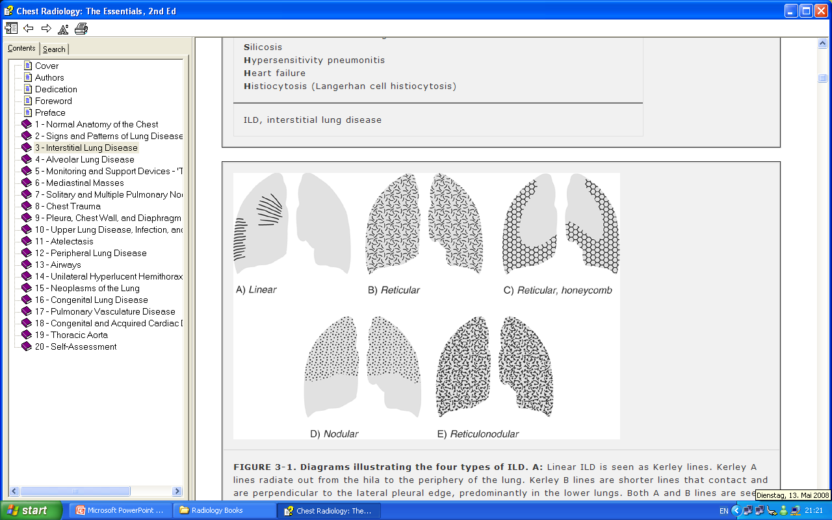
Patterns of Interstitial Lung Disease

Slide 33
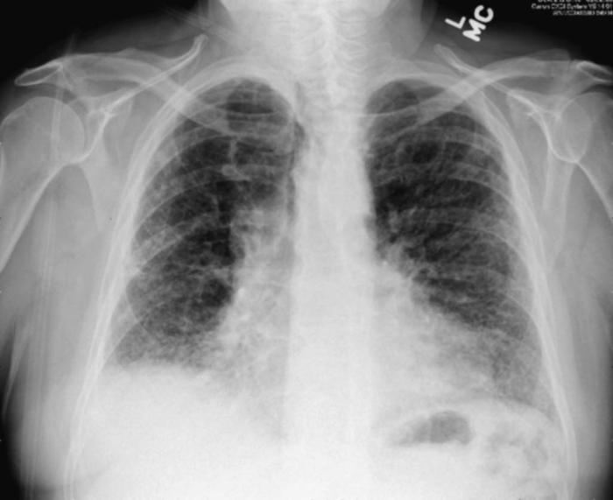
Chest X Ray
Typically small lung volumes with Reticular , Nodular, or RETICULONODULAR shadow

Slide 34
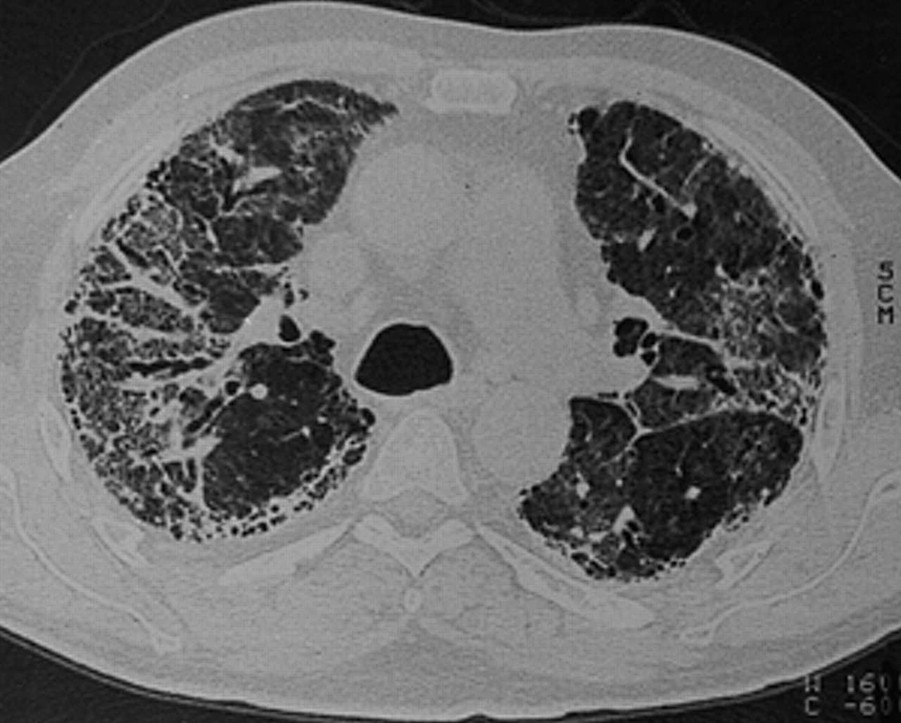
High-resolution Computed topography (HRCT)
HRCT is more sensitive
Combinations of ground glass changes, reticulonodular shadowing, honeycomb cysts and traction bronchiectasis

Slide 35
PULMONARY FUNCTION TESTING
Restrictive pathology
Grading the severity
Monitoring the response to therapy

Slide 36
PULMONARY FUNCTION TESTING
Restrictive Defect
↓ Lung volumes (TLC, FRC,RV <80%)
↓ FEV1, FVC With Normal or ↑FEV1/FVC
Reduced diffusing capacity (DLCO)
ABG Type 1 RF

Slide 37
LUNG BIOPSY
Transbronchial
Open lung biopsy
Not required to make the diagnosis in all patient with ILD.
To reach a definitive diagnosis or to stage a disease without examination of lung tissue.
Indication for lung biopsy:
- to assess disease activity
- to exclude neoplasm or infection
- to establish a definitive Dx before starting a treatment with serious side effects
-
37

Slide 38
MANEGEMENT
Principal aims:
(1) to remove exposure to injurious agents
(2) to suppress inflammation to prevent further destruction of the pulmonary parenchyma
(3) to palliate the manifestations of these diseases.

Slide 39
CORTICOSTERIODS
Prednisone, 1 mg/kg for 1 month
Gradually tapered (5 mg/week) over several months to a maintenance dose 10 mg daily

Slide 40
IMMUNO SUPpReSSIVE AGENTS
Cytotoxic agents (Cyclophosphamide)or immunosuppressive agents (Azathioprine) may be used in patients who do not improve on steroid therapy or who cannot tolerate corticosteroids

Slide 41
N-acetyl cystein
Antioxidant
600 mg PO tid added to prednisone and azathioprine, preserves vital capacity and FVC and DLCO

Slide 42

Pirfenidone
New DRUGS
Antifibrotic
Reduces acute exacerbations and reduction in FVC
Imatinib mesylate (A protein-tyrosine kinase inhibitor).

Slide 43
Oxygen therapy
  For patients with documented hypoxia– SpO2<89% , PaO2<55mmHg
  Improves exercise tolerance

Slide 44
Lung Transplantation
Failure of medical treatment
. Single lung transplantation is currently the preferred surgical operation.

Slide 45
Complications
Progressive respiratory failure
Pneumonia
Cor pulmonale
Pneumothorax
Bronchial carcinoma
Pulmonary embolism
Drug toxicity

Slide 46
Worse prognosis
Old age
Male
Smoking
Honeycombing
Lower DLCO < 40%
Higher rate of acute exacerbations
Pulmonary HT

Slide 47
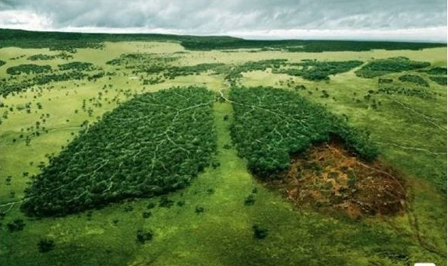
Thank you !!

